Slide 1
Chapter 3
Arithmetic for Computers
Notes:
Morgan Kaufmann Publishers
Chapter 3 — Arithmetic for Computers

Slide 2
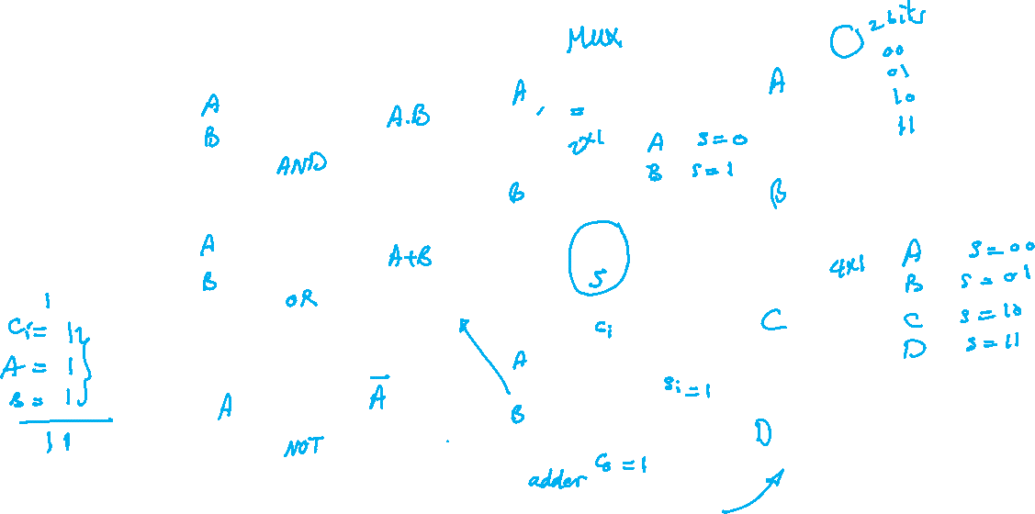
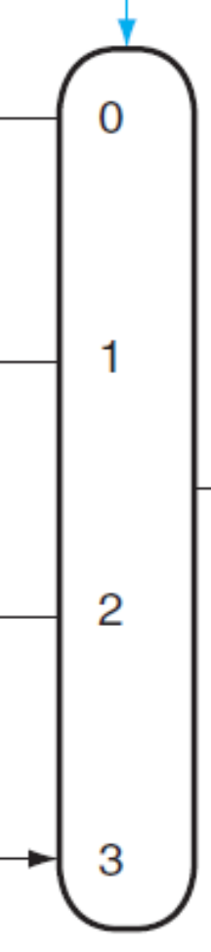
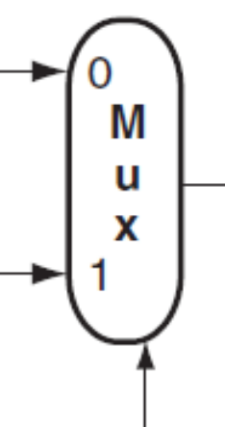

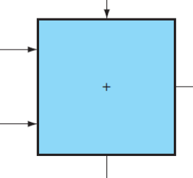
Basic Building Blocks
Chapter 3 — Arithmetic for Computers — <number>

Slide 3
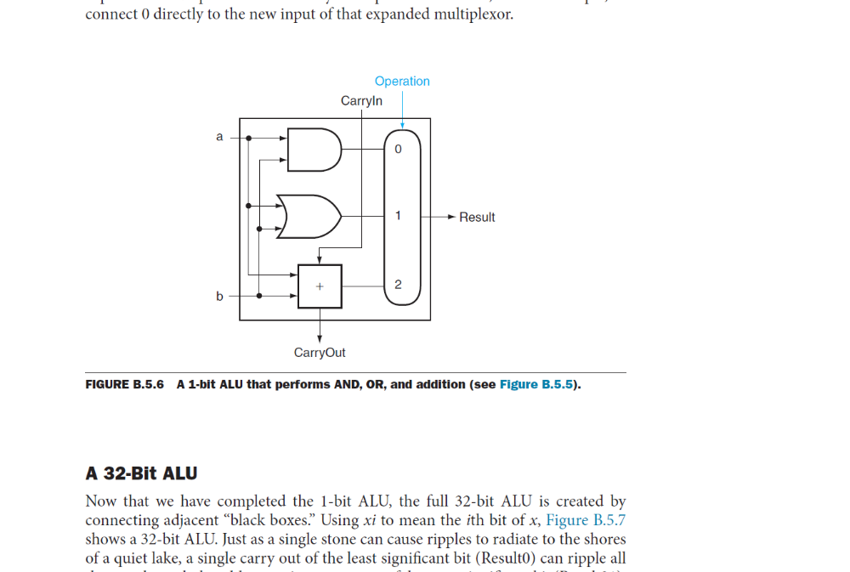
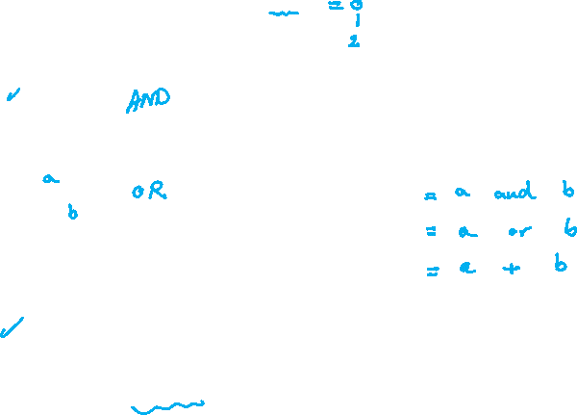
Simple 1-Bit ALU Design
Chapter 3 — Arithmetic for Computers — <number>

Slide 4
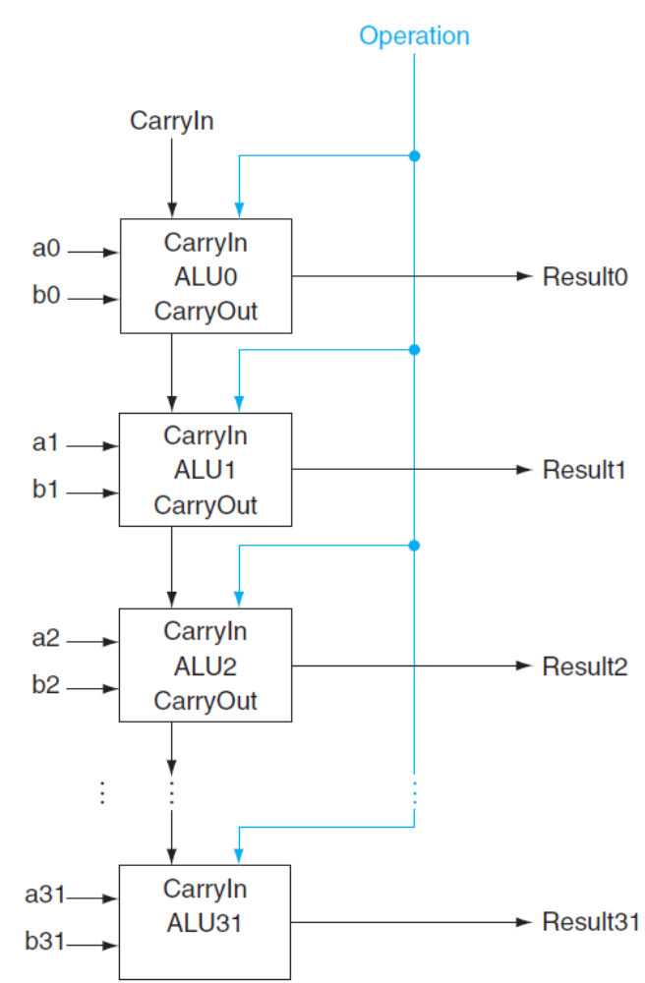
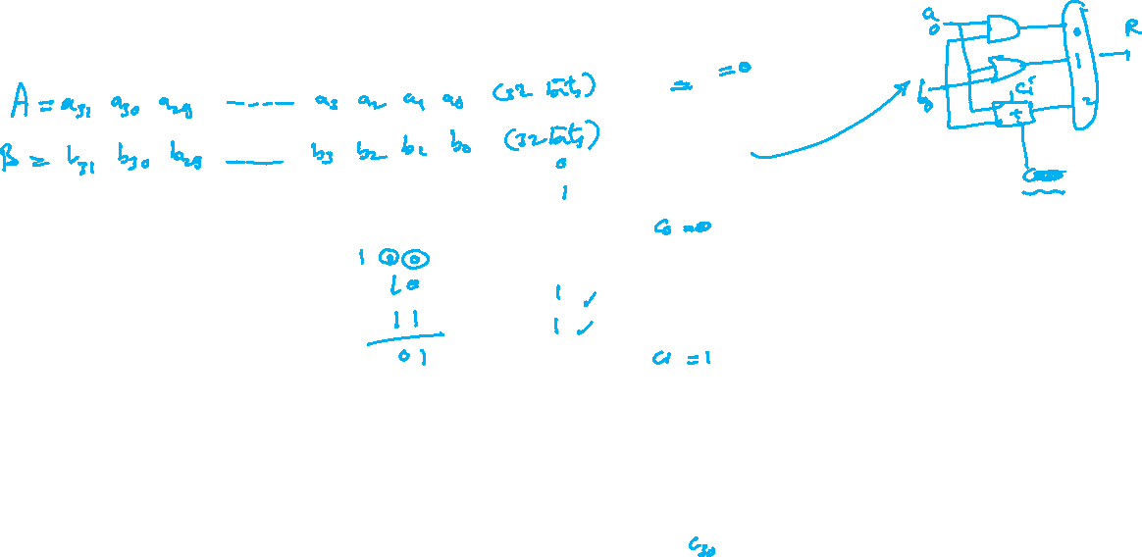
32-Bit ALU
Chapter 3 — Arithmetic for Computers — <number>

Slide 5
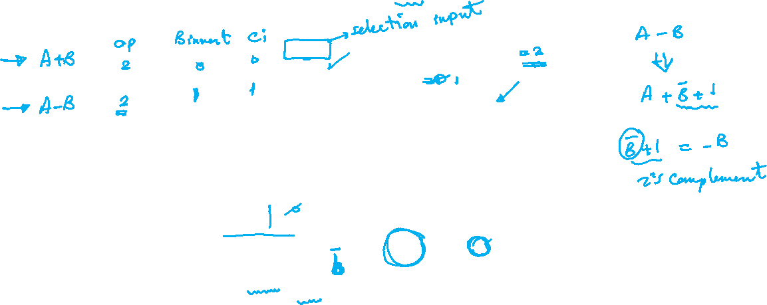
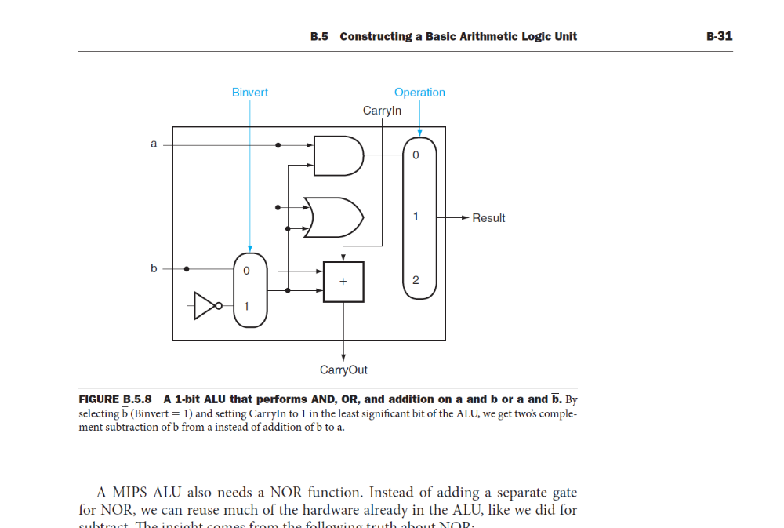
Incorporating Subtraction
Chapter 3 — Arithmetic for Computers — <number>

Slide 6
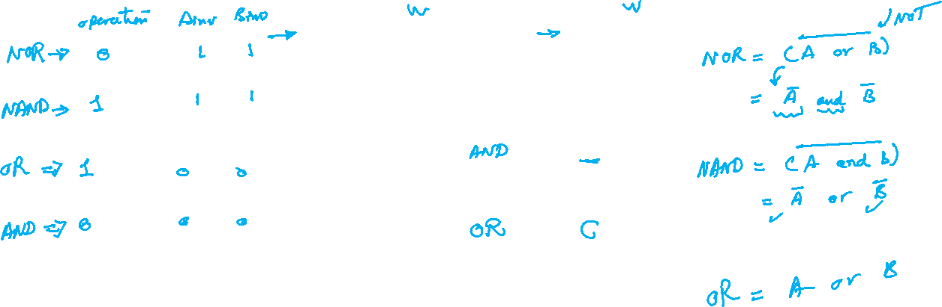
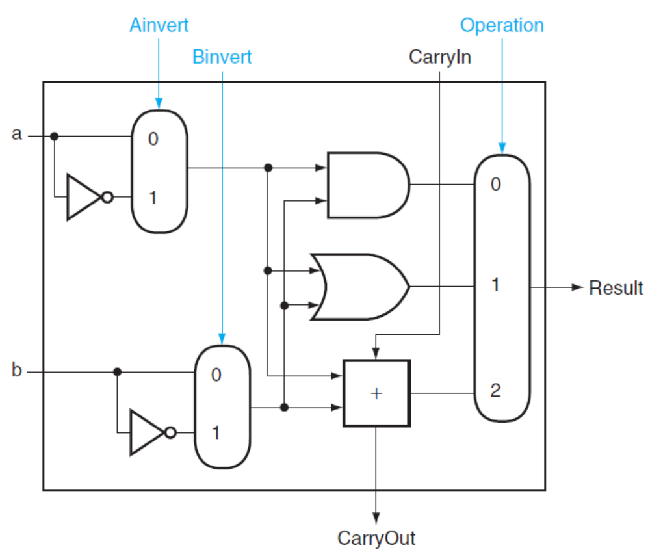
Incorporating NOR and NAND
Chapter 3 — Arithmetic for Computers — <number>

Slide 7
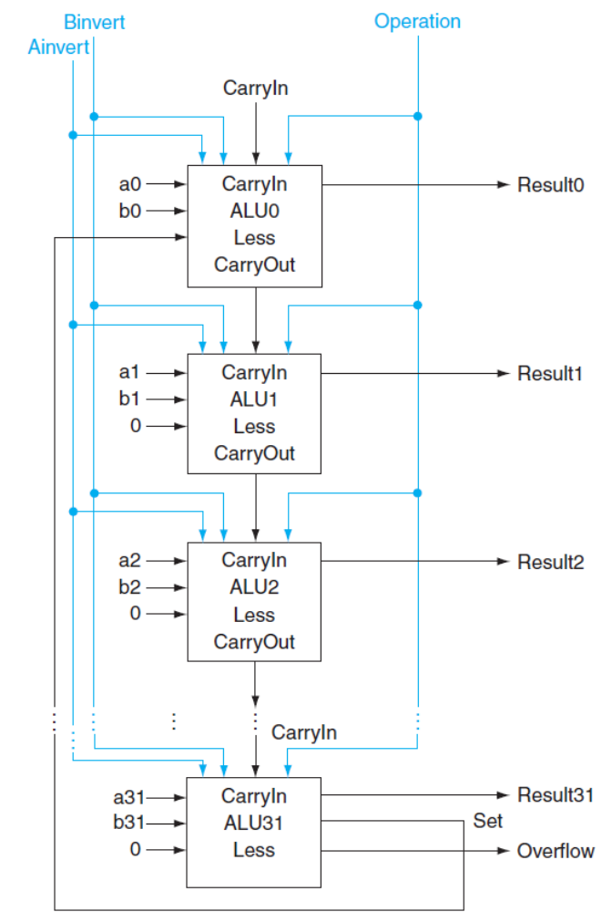
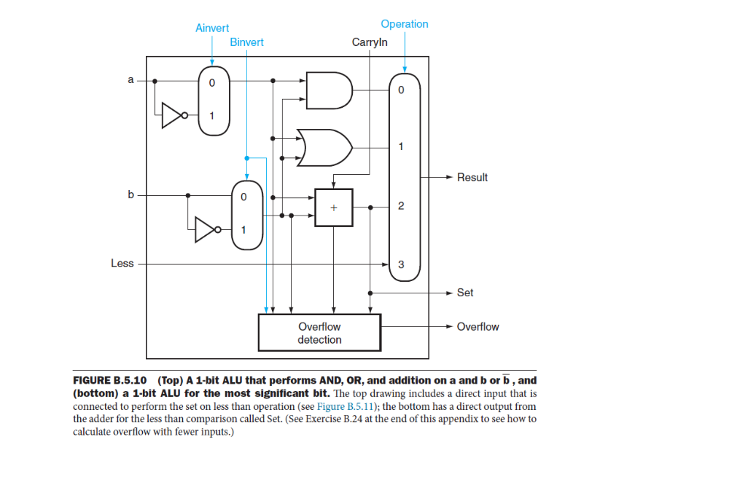
Incorporating slt
Chapter 3 — Arithmetic for Computers — <number>

Slide 8
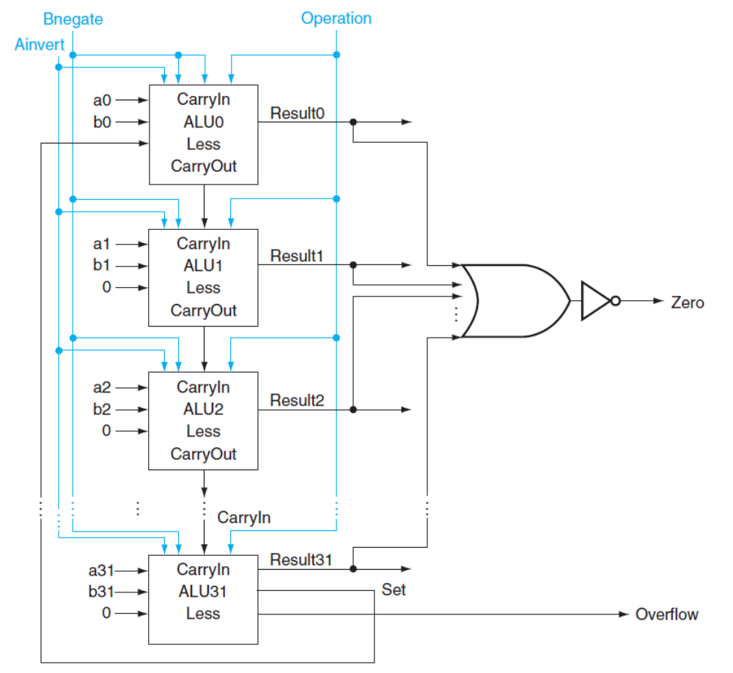
Incorporating beq
Chapter 3 — Arithmetic for Computers — <number>

Slide 9
Overflow Detecting Circuit
Chapter 3 — Arithmetic for Computers — <number>

Slide 10
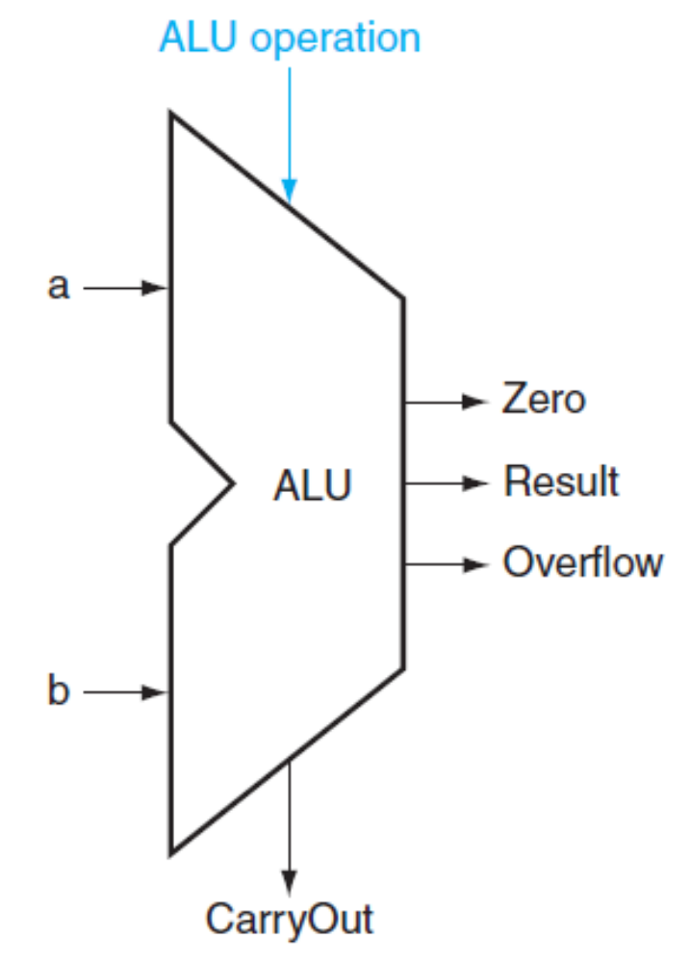
Opcodes
A’ | B’ | OP | Function
 |  |  | AND
 |  |  | OR
 |  |  | ADD
 |  |  | SUB
 |  |  | NOR
 |  |  | NAND
 |  |  | slt
 |  |  | beq
Chapter 3 — Arithmetic for Computers — <number>

